Slide 1
ORGANIZATIONAL BEHAVIOR

Slide 2
Organisational Behaviour
A field of study that investigates the impact that individuals, groups, structures have on behaviour within organisations for the purpose of applying such knowledge towards improving an organisations’ effectiveness.

Slide 3
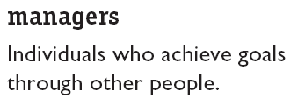
What Managers Do
Managerial Activities
Make decisions
Allocate resources
Direct activities of others to attain goals

Slide 4
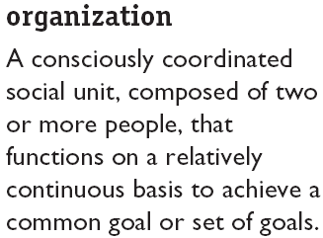

Where Managers Work

Slide 5
Management Functions
Planning
Organizing
Management
Functions
Controlling
Leading

Slide 6
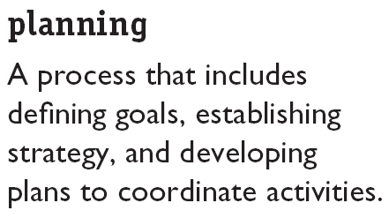

Management Functions (cont’d)‏

Slide 7
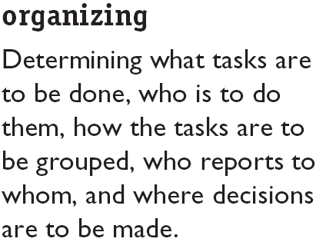

Management Functions (cont’d)‏

Slide 8
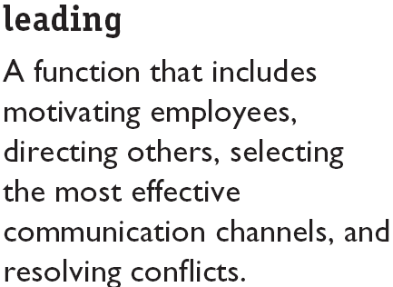

Management Functions (cont’d)‏

Slide 9
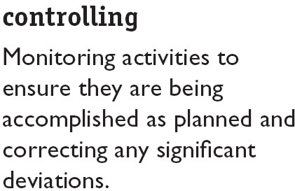
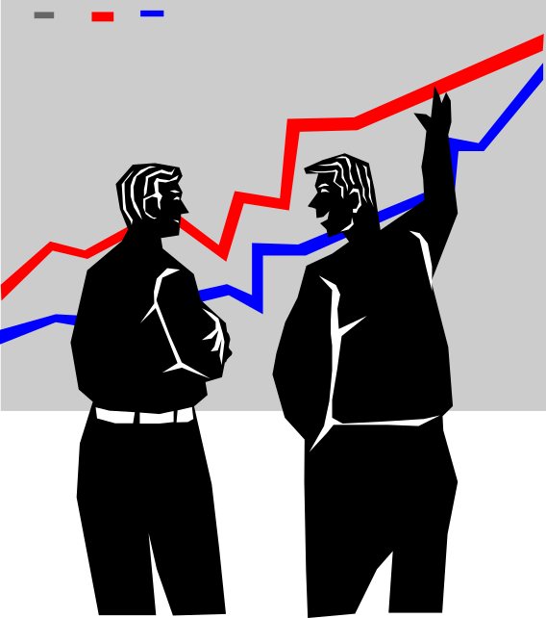
Management Functions (cont’d)‏

Slide 10
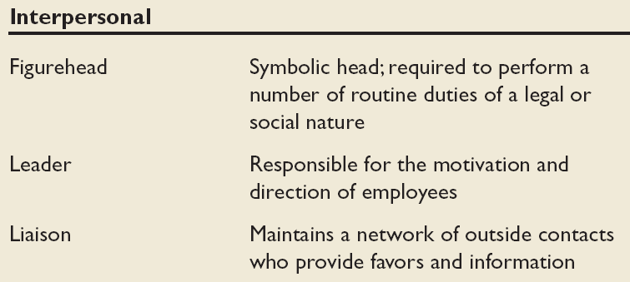
Mintzberg’s Managerial Roles (1960s)‏
A study on what managers do on their job

Slide 11
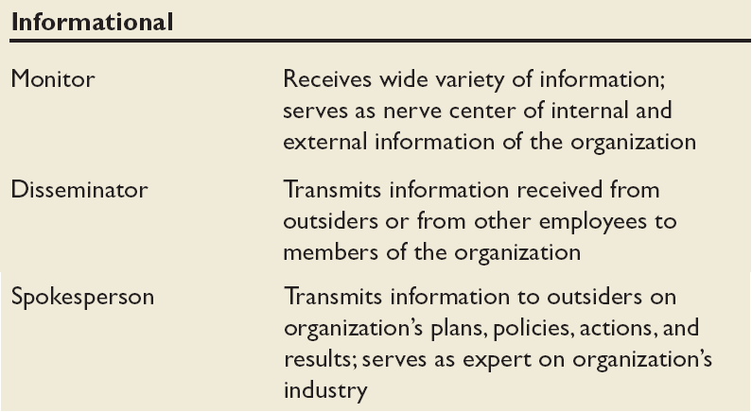
Mintzberg’s Managerial Roles (cont’d)‏

Slide 12
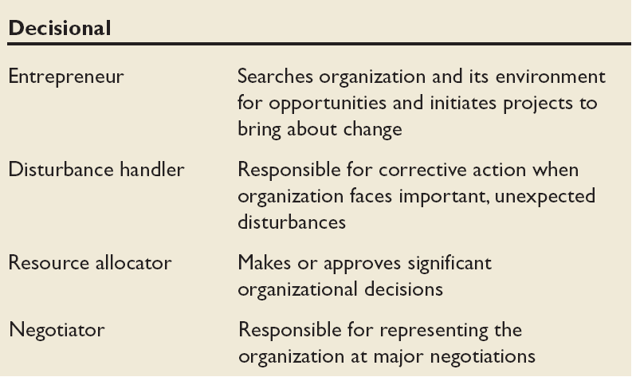
Mintzberg’s Managerial Roles (cont’d)‏

Slide 13
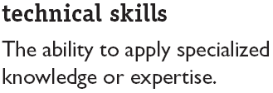

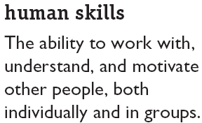
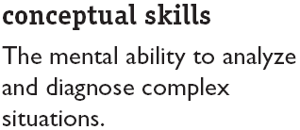
3 Management Skills – Robert Katz
Another perspective on what mangers do : look at their skills and competencies

Slide 14
Effective Versus Successful Managerial Activities (Luthans)‏
Different perspective : Do those who rise up quickly do the same activities with the same emphasis as those who do the best jobs?
Traditional management
  Decision making, planning, and controlling
Communications
  Exchanging routine information and processing paperwork
Human resource management
  Motivating, disciplining, managing conflict, staffing, and training
Networking
  Socializing, politicking, and interacting with others

Slide 15
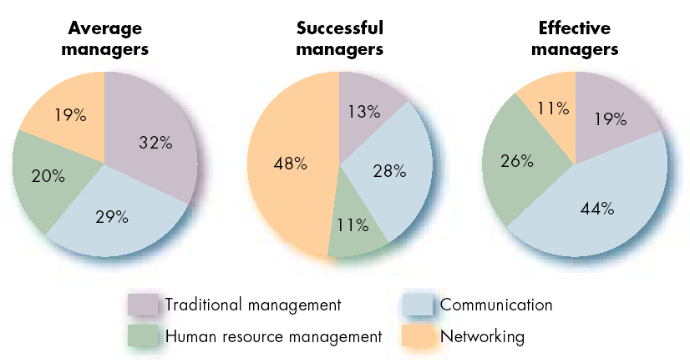
Allocation of Activities by Time

Slide 16
One Common thread that runs through the functions, roles, skills, activities and approaches to management
The importance of managing People

Slide 17
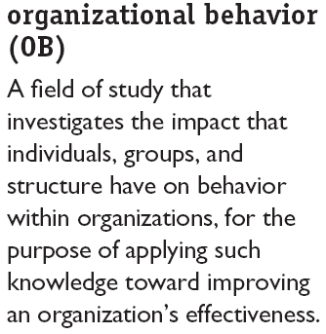
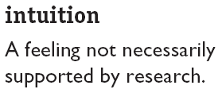
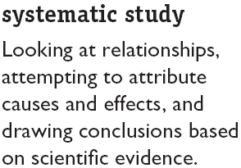
Enter Organizational Behavior

Slide 18
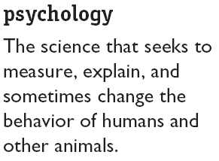
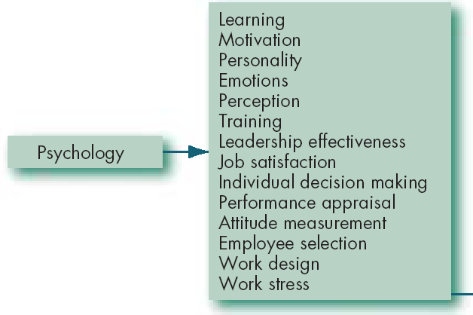
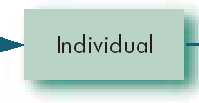
Contributing Disciplines to the OB Field

Slide 19
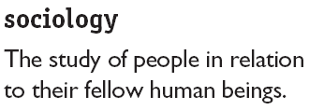
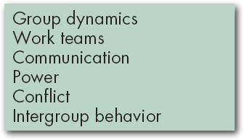


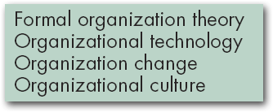

Contributing Disciplines to the OB Field (cont’d)‏

Slide 20
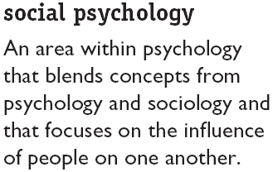
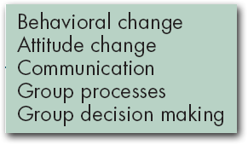

Contributing Disciplines to the OB Field (cont’d)‏

Slide 21
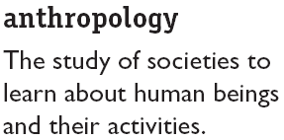
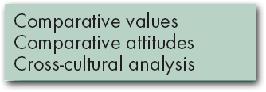


Contributing Disciplines to the OB Field (cont’d)‏

Slide 22
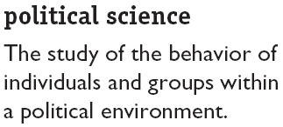
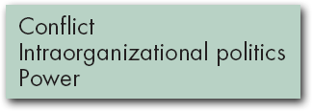

Contributing Disciplines to the OB Field (cont’d)‏

Slide 23
Enter Organizational Behavior

Slide 24
Contributing Disciplines to the OB Field

Slide 25
Contributing Disciplines to the OB Field (cont’d)‏

Slide 26
Contributing Disciplines to the OB Field (cont’d)‏

Slide 27
Contributing Disciplines to the OB Field (cont’d)‏

Slide 28
Contributing Disciplines to the OB Field (cont’d)‏

Slide 29
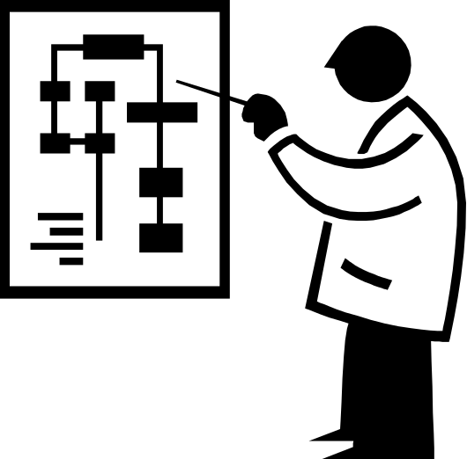
Challenges and Opportunity for OB
Responding to Globalization
Managing Workforce Diversity
Improving Quality and Productivity
Responding to the Labour Shortage
Improving Customer Service

Slide 30

Challenges and Opportunity for OB (cont’d)‏
Improving People Skills
Empowering People
Coping with “Temporariness”
Stimulation Innovation and Change
Helping Employees Balance Work/Life Conflicts
Improving Ethical Behaviour

Slide 31
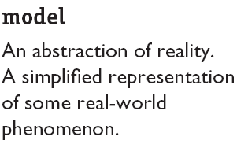
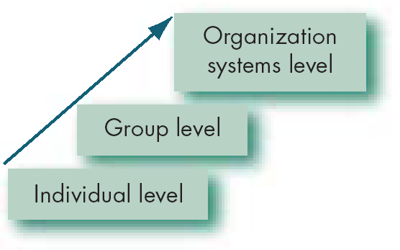
Basic OB Model, Stage I

Slide 32
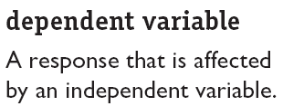
The Dependent Variables
y
x

Slide 33
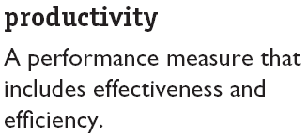


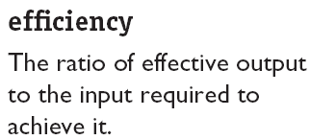
The Dependent Variables (cont’d)‏

Slide 34
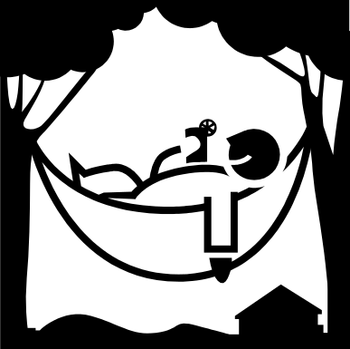


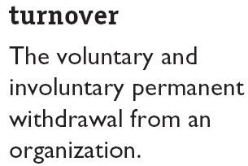
The Dependent Variables (cont’d)‏

Slide 35
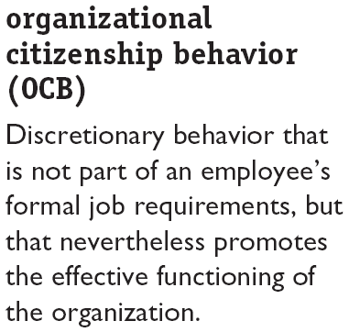
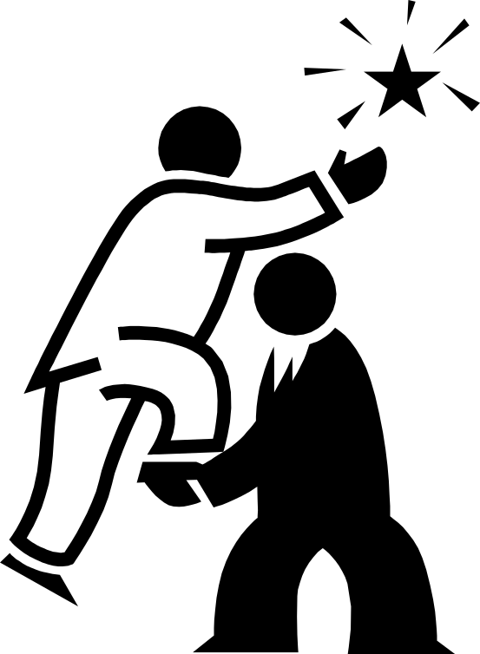
The Dependent Variables (cont’d)‏

Slide 36
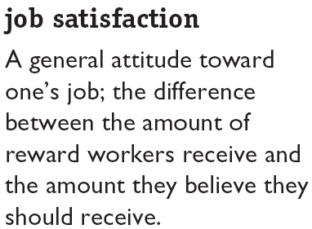

The Dependent Variables (cont’d)‏

Slide 37
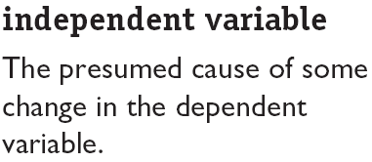
The Independent Variables
Independent
Variables
Individual-Level Variables
Group-Level
Variables
Organization
System-Level
Variables

Slide 38
Systems Level
HR policies & practice
Organisation structure & design
Organisational culture
Group Level
Group decision making
Leadership & trust
Conflict
Power & politics
Communication
Group structure
Individual Level
Biographical characteristics
Personality & emotions
Values and attitudes
Perception
Individual decision making
motivation
Productivity
Absenteeism
Turnover
Deviant work behaviour
Job satisfaction
Organisational citizenship behaviour

Slide 39
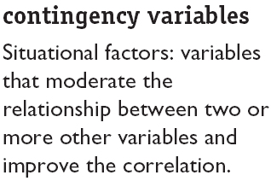
There Are Few Absolutes in OB
Contingency
Variables
x
y

Slide 40
Frederick W Taylor (1856 – 1917)‏
Pricipal object of management
  To secure maximum prosperity for employer and employee
Management and workforce are inter-dependent
Workmen are capable of hard work, good will and ingenuity
Proposed 4 underlying principles of management:
  Need to develop a ‘science of work’
  Workers to be ‘scientifically’ selected and developed
  Combine first two to get best results
  Divide work and responsibility equally between workers and management

Slide 41
Alfred P Sloan (1875 – 1966)‏
Joined General motors in 1917, became president in 1923
Rejected centralisation of power
Looked more to Henri Fayol’s functional approach
Developed systematic strategy planning and managerial accountability

Slide 42
Elton Mayo (1880 – 1949)‏
Influential in ‘Hawthorne experiments’ (Western Electric Co., USA, 1927-32)‏
  Large scale experiments (20,000 employees)‏
  Work satisfaction and hence performance is basically not economic
  Rejected ‘Taylorism’ and its emphasis on employee self-interest
  The influence of ‘peer group’ is very high
  Denounced ‘rabble hypothesis’ that society is a horde of unorganised individuals concerned with self preservation and self-interest

